Slide 1

NYC data Property Analysis -Final capstone Project
Sucheta Gangullapattu

Slide 2
Introduction / Business Problem
New York City is the largest Metropolitan city with diverse culture and Financially , Economically Power House.
Exploring NYC Sales Data to find out answers to some of the questions Below:
As we can Know from the statistics NYC, NYC is a very diverse and financial capital, we can derive many ideas and problems like:
if I am looking to open a restaurant or business, I would like to explore neighborhoods /areas with low real estate property values?
If someone is looking for office / house to rent which area should they prefer and why?

Slide 3
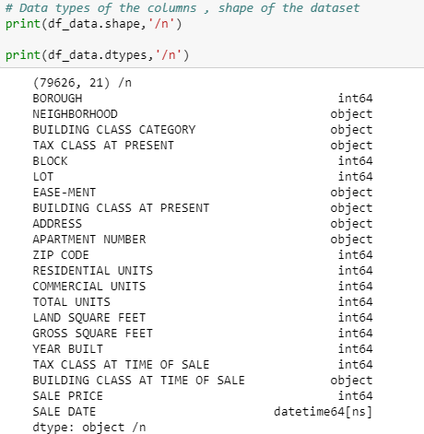
Data Understanding and Cleansing
NYC Sales data Has been acquired from (12-Month Period 2018) https://www1.nyc.gov/site/finance/taxes/property-rolling-sales-data.page
Foursquare Location Data is also used
Data consists of rolling property sales data for all 5 boroughs and information about taxes, type of property, neighborhood, date of sales, square footage info etc.
The data corresponds to 12-month period (year 2018). The source has sales data recorded per each Borough. The Sale data has been consolidated into one data source.
The data consists of 5 Boroughs (Manhattan (1), Brooklyn (3), Staten Island (5), Bronx (2), Queens (4)).
As we can there are 79626 Records , 21 Columns in total .
Figure in the Picture shows Column Information.
Duplicates, Null Values , invalid entries were dropped.

Slide 4
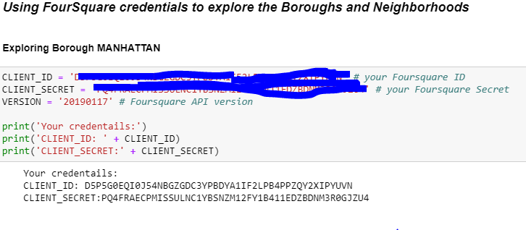
Methodology
Foursquare API is used to for exploring / obtaining venue information.
Foursquare user information, explore geographical information and to get trending venues around a location.
Foursquare API can be used by Constructing an URL with credentials obtained by signing up into Foursquare and sending a request to the API for search of a specific venue, to explore the geographical locations around a venue etc.
Note: The snap shots that are taken to show as results, from Borough Manhattan.
The above process is carried out for Each Borough and their neighborhoods (Brooklyn, Bronx, Staten Island, Queens, Manhattan).
Call is made to Foursquare API , an URL is generated in the next step using Credentials.
The URL is processed, and result is captured in json file which contains venue information .
Python function is used to retrieve information from of all venues corresponding to each Neighborhood resulting into a data frame containing Latitude, longitude, Venue, Venue category, Neighborhood information.

Slide 5
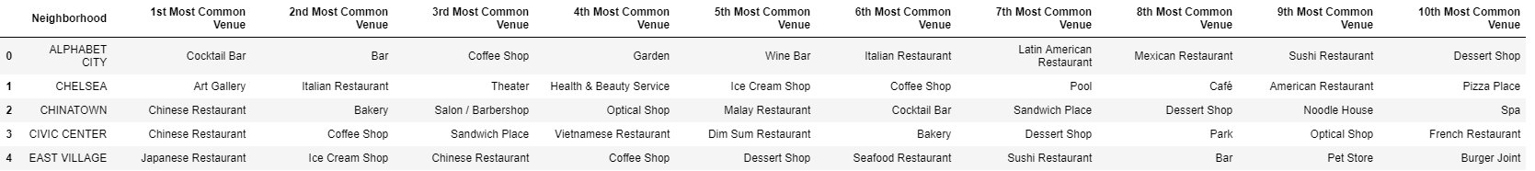
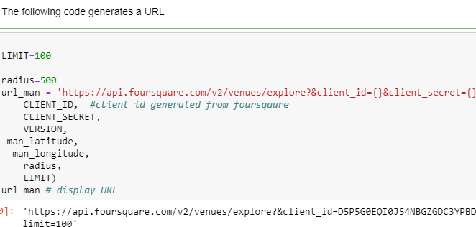
As we can see from the snapshot URL takes longitude and latitude information , for example Manhattan Borough is shown.
Note: This processes is repeated to get venue information for all 5 Boroughs separately.
The result is venues data and frequency of occurrence of venues data for each Borough(Manhattan , Brooklyn, Bronx, Staten Island, Queens)
The result sets for Boroughs Brooklyn, Bronx, Staten Island, Queens:
Top 10 most common Venues in each Neighborhood and across all Boroughs.

Slide 6
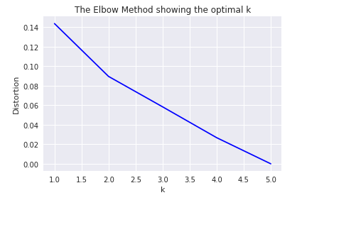
Feature Selection : K-Means and Elbow Method
Longitude and latitude Features of 5 Borough to calculate clusters has been used.
The dataset of neighborhood venues for all 5 boroughs in New York City is consolidated to one dataset. For each venue category, the mean of frequency of venues across each neighborhood was calculated using one –hot Encoding. This information would then be used to fit a K-Means clustering algorithm to the data to determine neighborhoods of similar venue profile.
K-means is an unsupervised learning methods of clustering unlabeled data into k clusters.
K-means is used in this project to cluster Neighborhoods of NYC and their Boroughs.
Determine Optimal K : Elbow Method
The technique to determine K, the number of clusters, is called the elbow method.
Values for k on horizontal axis and Distortion (% of variance) Vertical axis
When K increases, the centroids are closer to the cluster’s centroids. The improvements will decline, creating the elbow shape.
From The figure we can see that K=2

Slide 7
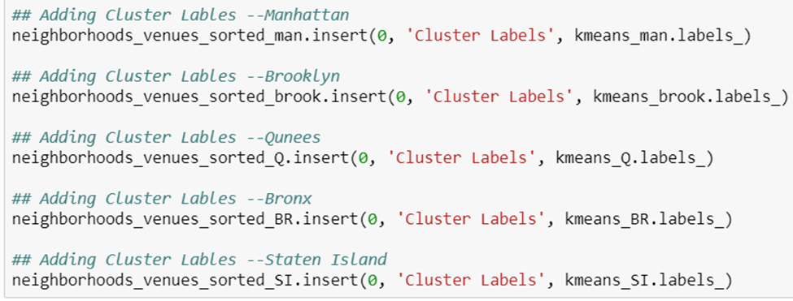
Adding Cluster Label's
Cluster labels for Each Borough has been created and added to there corresponding datasets.
As we can see from the snapshot Cluster labels for each Borough is created and added.
Creating New Data frame by combining Data from data set with clusters labels and top 10 most common venues for all 5 Boroughs and its Neighborhoods.

Slide 8
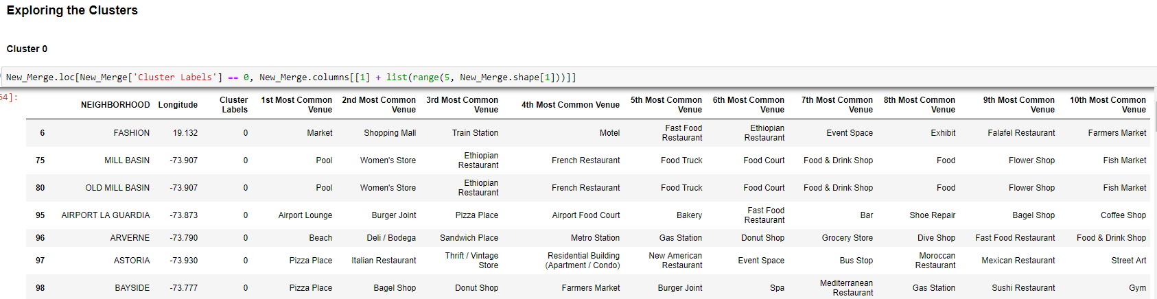
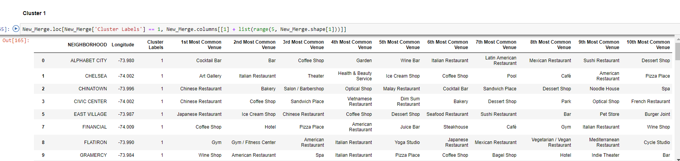

Slide 9
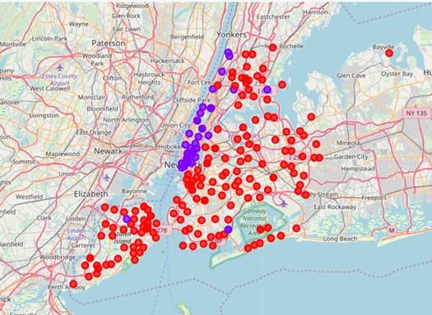
Map with Clusters

Slide 10
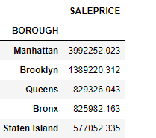
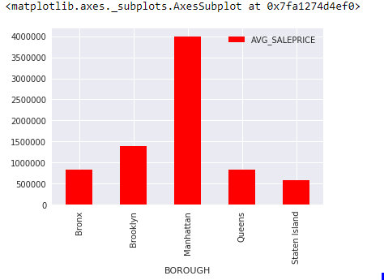
Data Analysis Sale Price And Other Features
Brough Manhattan has the highest Average Priced Properties and least Price is Staten Island

Slide 11
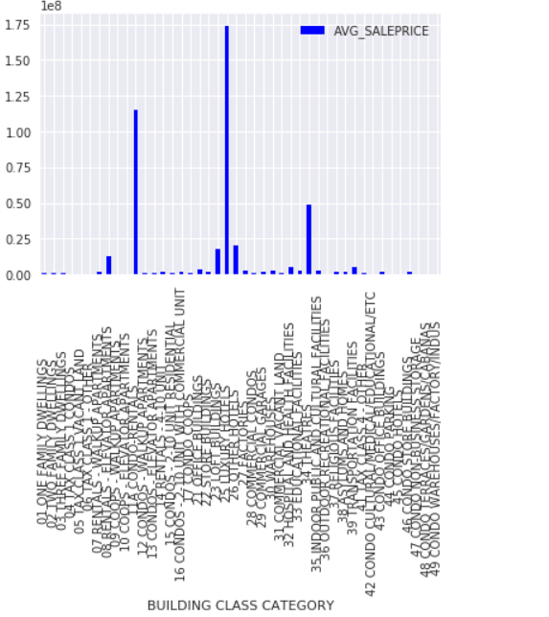
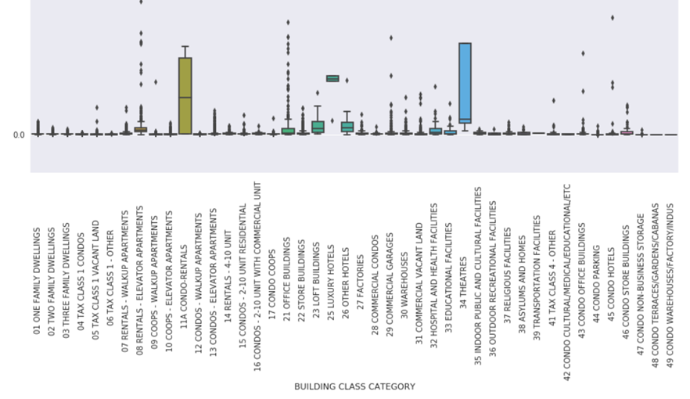
Building Class Category and its Sale Price Distribution
As the figure indicates 25 LUXURY HOTELS , 11A CONDO-RENTALS , 34 THEATRES , are highly Priced Building Class Categories
Least Priced : CONDO NON-BUSINESS STORAGE, CONDO WAREHOUSES/FACTORY/INDUS

Slide 12
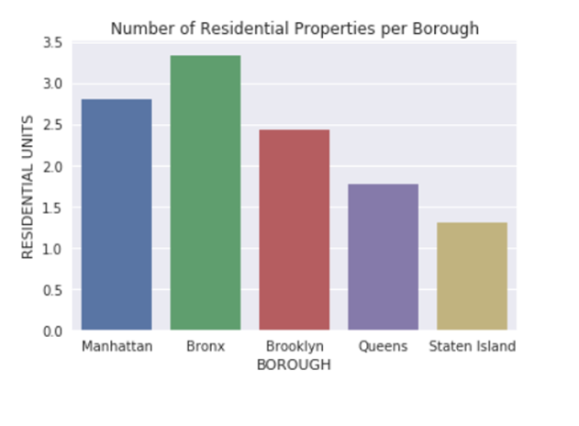
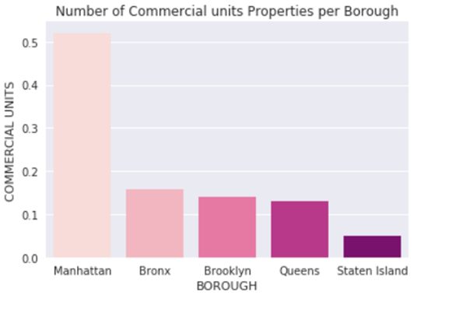
Residential Vs Commercial Properties
The plot shows that Borough Bronx has more Residential properties than the other Boroughs.
The plot shows That Manhattan houses the highest number of commercials properties.

Slide 13
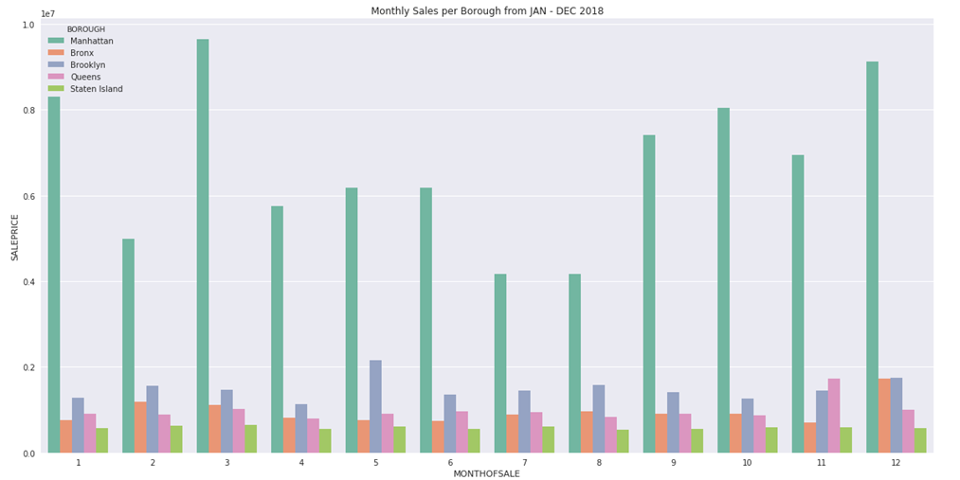
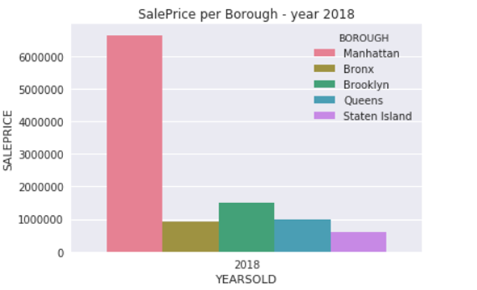
Borough with Highest Sale Price for sale year -2o18
Highest Sale Priced Properties in Year -2018 were sold in Borough Manhattan.
Monthly Sales Per Borough from Jan -Dec 2018
Borough Manhattan sold Properties with high sale price in Month 3rd (March) and 12th(December).
Manhattan property Sales Price drooped in month 6th(June) and July

Slide 14
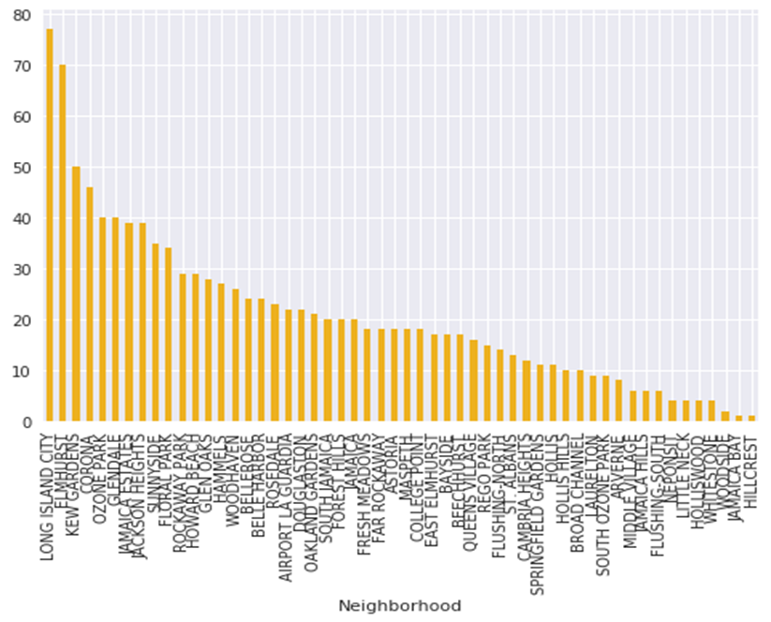
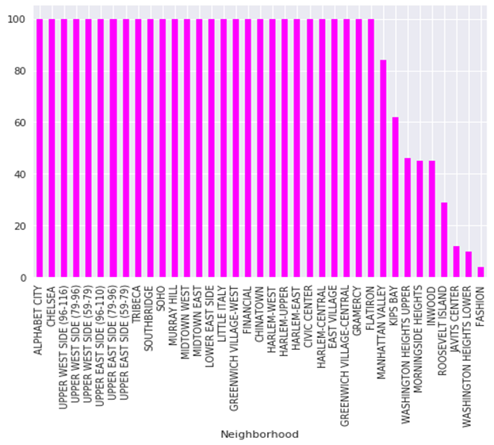
Venues per Neighborhood
1 . Figure 1 shows Number of venues in a Neighborhood belonging to Borough
Queens
Neighborhoods Long Island City, Elmhurst, Kew Gardens have a greater number of venues then rest of the Neighborhoods in Queens Borough.
2 . Figure 2 shows Number of venues in a Neighborhood belonging to Borough
Manhattan
Majority of Neighborhoods have almost same number of venues in Manhattan Borough

Slide 15
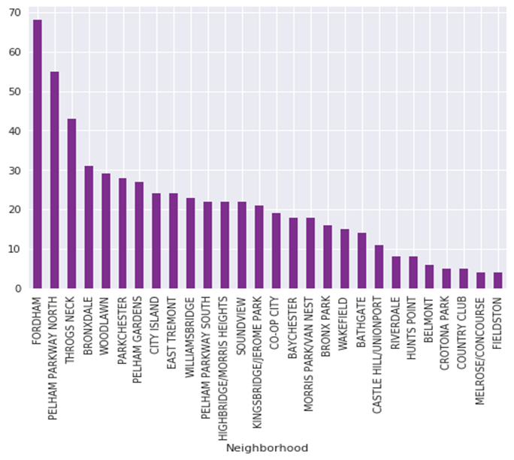
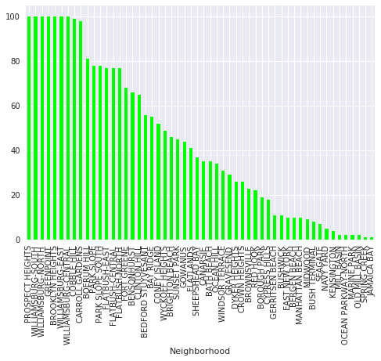
1 . Venues per Neighborhood Brooklyn
As we can see from the figure in Green Bars :Prospect Heights, Williamsburg-south, Williamsburg-North , Green points and Brooklyn Heights have larger group of venues in Brooklyn Borough.
Whereas Jamaica Bay, Spring creek and old mill basin have least number of venues.
2. Venues per Neighborhood Bronx
Fordham, Pelham parkway station and Throgs Neck Neighborhood have a greater number of venues than the rest of the neighborhoods in Bronx.

Slide 16
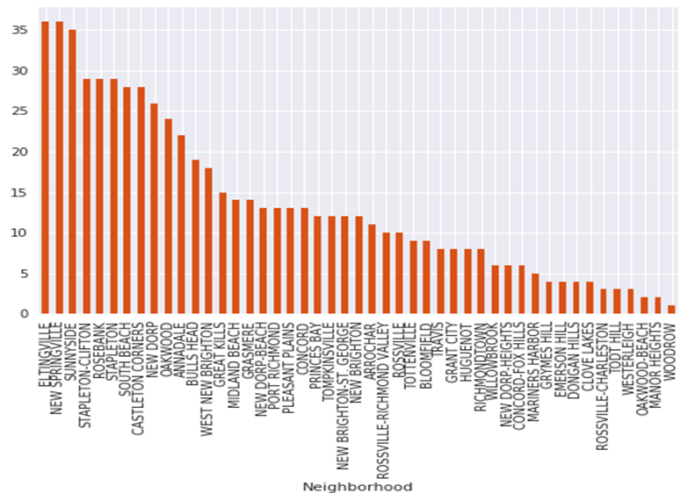
Venues per Borough Staten Island
From the figure Eltingville , New Springville , Sunside hold maximum number of venues in Staten Island Borough.

Slide 17
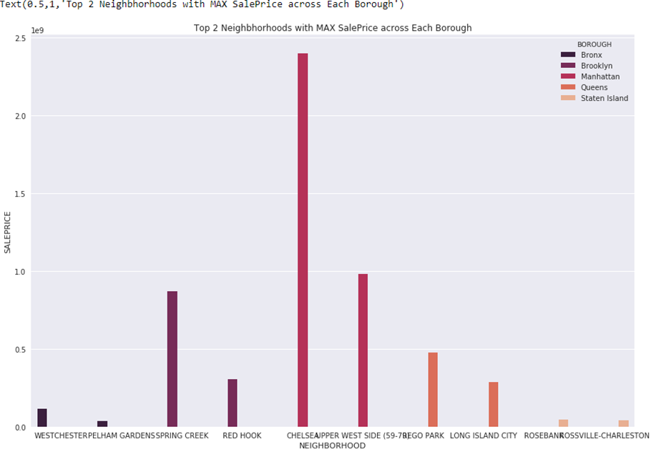
Top Neighborhoods in Each Borough With Max Sale Price
Manhattan: CHELSEA, UPPER WEST SIDE (59-79)
Brooklyn: SPRING CREEK, RED HOOK
Queens: LONG ISLAND CITY, REGO PARK
Bronx: WESTCHESTER, PELHAM GARDENS
Staten Island: ROSEBANK, ROSSVILLE-CHARLESTON
Cont.……

Slide 18
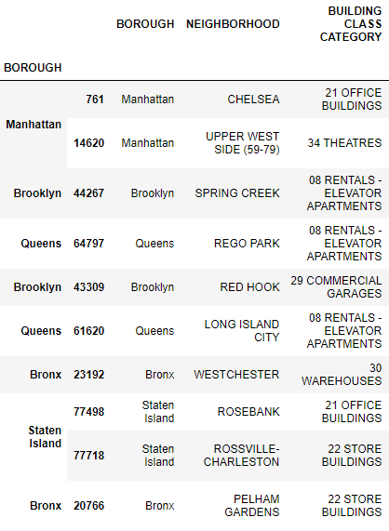

Building Class Category /Sale Price
From the data we can see that Manhattan Borough has Highest priced
Neighborhoods with Building Class Category : 21 OFFICE BUILDINGS
And 34 THEATERS
Borough Brooklyn has second highest priced Building class Categories namely
COMMERICAL GARAGES and RENTAL ELEVATOR APARTMENTS.
As we can see Building Class Category – RENTAL ELEVATOR APRATMENTS
in Spring Creek- Brooklyn are Highly Priced than Rego Park in Queen's borough.
Building Class Categories in Bronx – WAREHOUSES in Westchester have higher
Sale Price than Staten Island Building Class categories –OFFICE BUILDINGS,
STORE BUILDING
In Staten Island Building class category – STORE BUILDINGS are highly Priced than
Bronx – Pelham Gardens.

Slide 19
Conclusion
Observations :
In Manhattan Borough its been observed as per the analysis the Property Prices in Neighborhoods CHELSEA, UPPER WEST SIDE have high property Sales Price and Number of Venues are also more.
In Brooklyn Borough Neighborhoods SPRING CREEK has lower venues a comapred to RED HOOK.
In Queens Borough Neighborhoods : LONG ISLAND CITY have large number of venues and the Highest sale priced properties where as number of venues in are considerably lower in REGO PARK
In Bronx Neighborhoods PELHAM GARDENS has more Venues than WESTCHESTER, WESTCHESTER has Higher Sale Priced Building category property.
In Staten Island Neighborhoods ROSEBANK has more venues then ROSSVILLE-CHARLESTON where as in terms of properties with the borough ROSSVILLE-CHARLESTON hold higher sale priced properties
A stack holder or a Potential Business man can explore more about selling / Buying or exploring to open new ventures in New York City through similar analysis of this kind.
This project could be explored in terms of using foursquare API to dive deep into elaborating / choosing on specific venues /venue locations and carrying out analysis using any other clustering algorithm.

Slide 20
Reference
https://en.wikipedia.org/wiki/Neighborhoods_in_New_York_City
https://www1.nyc.gov/site/finance/taxes/property-rolling-sales-data.page
Foursquare API
K-means Algorithm

